Slide 1
A Strategic Service Model for Performance Oriented HRD
“Case Study of Strategic Training Program for Strengthening Future-Oriented Public Leadership”
Howard ‘Hunhueon’ Cho
Human Resources Development Institute of KOREA

Slide 2
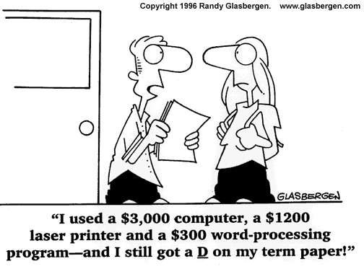
Wishes
Flipped Learning
PBL
AGILE
GBS
Situated Learning
Bite-Size Learning
ADDIE
Case-based reasoning
Informal Learning
Total Learning
Rapid ISD
Constructivism

Slide 3
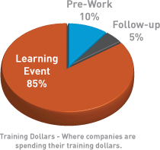
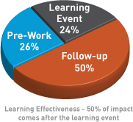
Changes
Training Director
Tactics /Safe operation
CLO Chief Learning Officer
Strategy / HRD-Performance
CKO Chief Knowledge Officer
Transition / Innovation
Learn
Perform
Succeed
Peterson, Brent. (2004). Unpublished paper from Apollo Consulting Group. University of Phoenix

Slide 4
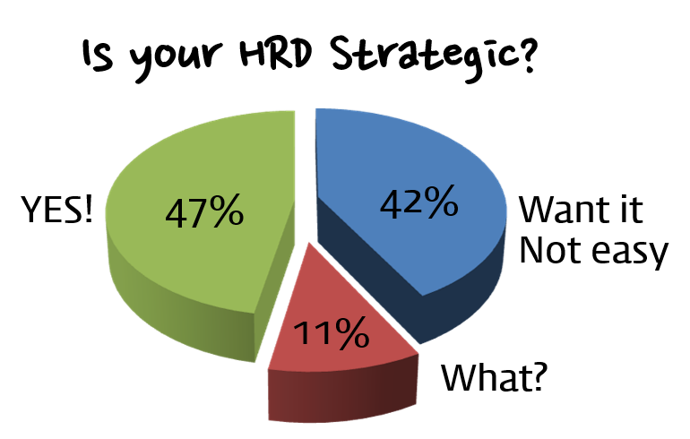
Changes
Training Director
Tactics /Safe operation
CLO Chief Learning Officer
Strategy / HRD-Performance
CKO Chief Knowledge Officer
Transition / Innovation
Learn
Perform
Succeed
Samsung Multi-Campus [20 Korean Major Companies, 2015]

Slide 5
Strategic HRD?
Organization’s Value System
Mission/
Core Value/
Vision
Alignment
Process
Job Group / Duty [Strategic Placement]
Competency
Assessment
Career Planning
Competency
Development Support
Development Action
Performance Analysis
System
/
Model
Job Structure
Competency
Library
Career Path
CBC
LMS
[On/Off]
Competency + Performance MGT system
DATA
Competency Assessment History
Career Dev.
Curriculum Dev. History
Self Dev. MGT
History Analysis
HR MGT
Competency Assessment
CDP
Training
Prediction
Recruit Strategy
Relocation
Replacement
Hurdle? Or Info.?
Accumulation & Analysis
Vital Info. For Dev.
Career Vision
Job Transfer
Mid to Long term
CBC
Link to Performance Analysis
Link to HRM
Technology Ready (Make it neutral)
Policies
HRM
Management
Employee
HRD
Performance Analysis on demand
Link HRD to HRM
Comprehensive HR Planning
Partner for HRD
Responsibility for subordinate
Training Result Monitoring
Competency MGT.
Mid to Long term CDP Design
Job-centered Self. Dev.
Dev. Strategy Design
Training Delivery & Quality MGT.
History Management

Slide 6
Piece of Cake?
Organization’s Value System
Mission/
Core Value/
Vision
Alignment
Process
Job Group / Duty [Strategic Placement]
Competency
Assessment
Career Planning
Competency
Development Support
Development Action
Performance Analysis
System
/
Model
Job Structure
Competency
Library
Career Path
CBC
LMS
[On/Off]
Competency + Performance MGT system
DATA
Competency Assessment History
Career Dev.
Curriculum Dev. History
Self Dev. MGT
History Analysis
HR MGT
Competency Assessment
CDP
Training
Prediction
Recruit Strategy
Relocation
Replacement
Hurdle? Or Info.?
Accumulation & Analysis
Vital Info. For Dev.
Career Vision
Job Transfer
Mid to Long term
CBC
Link to Performance Analysis
Link to HRM
Technology Ready (Make it neutral)
Policies
HRM
Management
Employee
HRD
Performance Analysis on demand
Link HRD to HRM
Comprehensive HR Planning
Partner for HRD
Responsibility for subordinate
Training Result Monitoring
Competency MGT.
Mid to Long term CDP Design
Job-centered Self. Dev.
Dev. Strategy Design
Training Delivery & Quality MGT.
History Management

Slide 7
What is LADDER?
Compression
It is a systematic HRD service model that enables optimized results through effective implementation of comprehensive strategic HRD as an institution leading the education of public officials in Korea.
Revise
Make it better
Make Better
Virtuous cycle as institutional Ethic & Philosopy
Execute
Make Changes
Applying
Right Push, make it settle
Deliver
Transfer
Implanting
Good result by right delivery
Develop
Customize
Design Map-tailored solution and applying optimal instructional methodology
Customizing
Analyze
Object Squeezing
Objective Squeezing
Clarify the client’s needs through the comprehensive analysis of the data collected from the [Listen] Phase
Listen
Data Mining
Discover Client’s Needs [VOM/VOW/VOC]

Slide 8
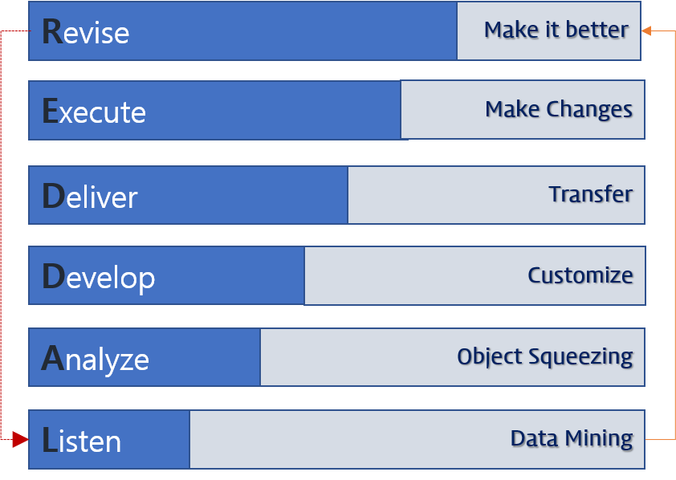
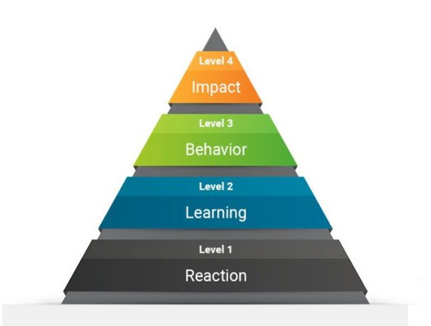
What is LADDER?
Little Deeper
POST Training
Training
PRE
Training
Listen
Analyze
Develop
Deliver
Execute
Revise
Public
Planning
Analysis
Customize
Faculty
Apply Knowledge
Improvements
VOL.W.C
Instruction Design
Evaluation Data
Evaluation Data
Learner
SMEs
Evaluation Data

Slide 9
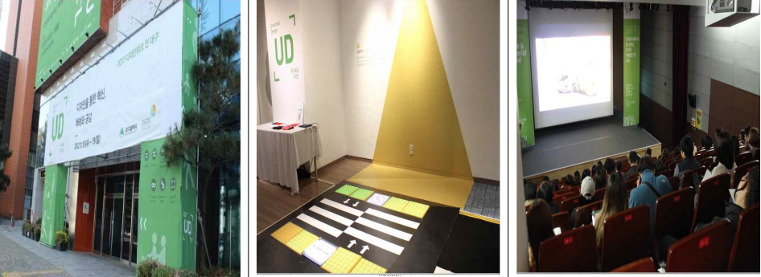
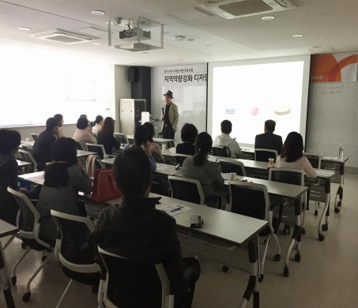
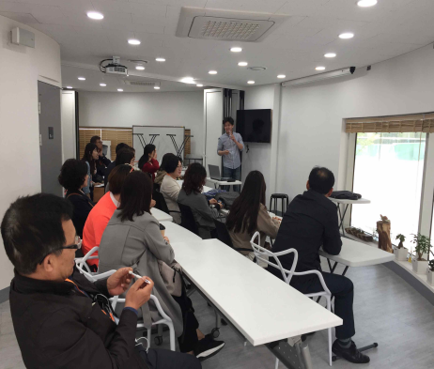
CASE
Daegu Metropolitan City’s [Public Design Course]
Process
Details
• Learning Purpose Feasibility Analysis (Survey)
• 2019 Daegu Metropolitan City Design Week Participation (VOC Survey)
360 Stakeholder Survey (SME/VOC/VOB Survey: n=106)
Task analysis, demand analysis by position/area
Listen
Analyze
Design
Deliver
Execute
Revise

Slide 10
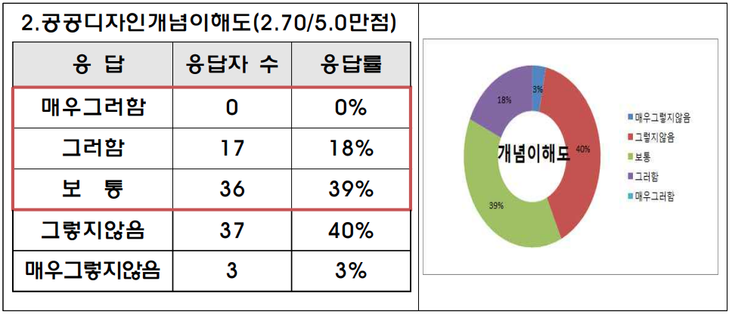
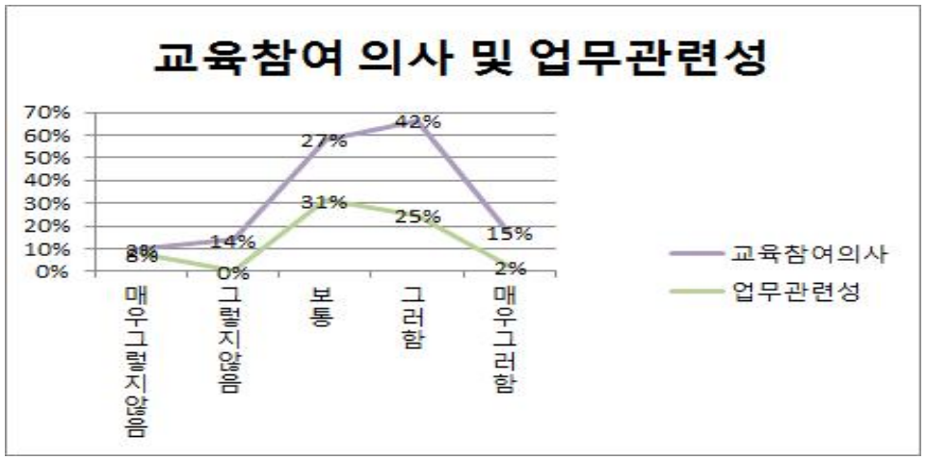
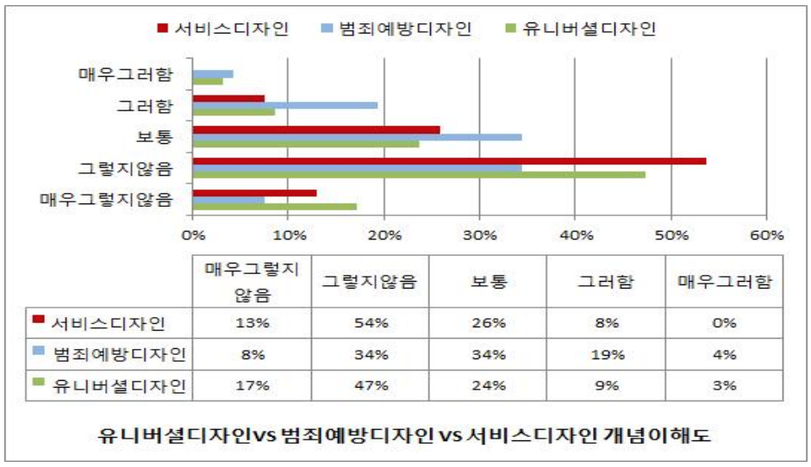
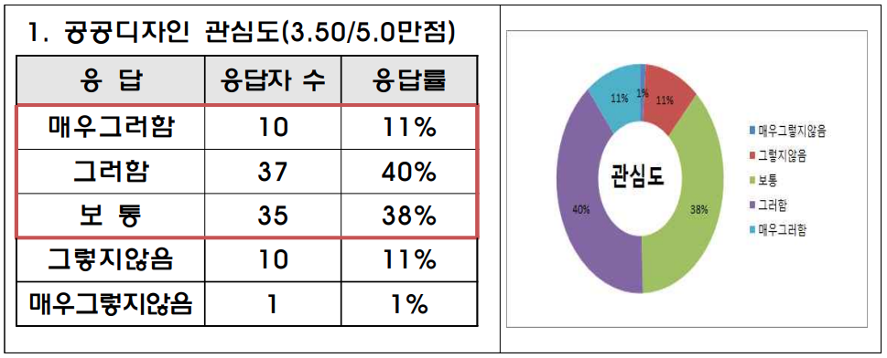
CASE
Daegu Metropolitan City’s [Public Design Course]
Process
Details
• Learning Purpose Feasibility Analysis (Survey)
• 2019 Daegu Metropolitan City Design Week Participation (VOC Survey)
360 Stakeholder Survey (SME/VOC/VOB Survey: n=106)
Task analysis, demand analysis by position/area
Listen
• Classification of Targeted competencies / Target level specification
• Classification of perspectives to ensure justification for development
• Derivation of integrated process goals through gap analysis
Analyze
Design
Deliver
Execute
Revise

Slide 11
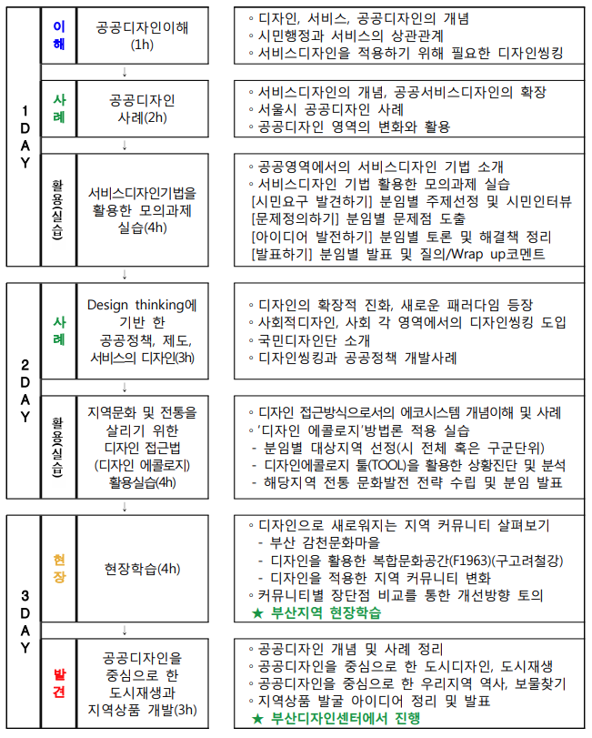
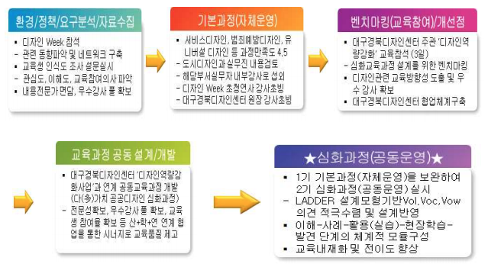
CASE
Daegu Metropolitan City’s [Public Design Course]
Process
Details
• Learning Purpose Feasibility Analysis (Survey)
• 2019 Daegu Metropolitan City Design Week Participation (VOC Survey)
360 Stakeholder Survey (SME/VOC/VOB Survey: n=106)
Task analysis, demand analysis by position/area
Listen
• Classification of Targeted competencies / Target level specification
• Classification of perspectives to ensure justification for development
• Derivation of integrated process goals through gap analysis
Analyze
Content details and development method design
Course goal-contents consistency evaluation
Design of evaluation method for achievement of learning goals
Pilot Testing
Design
Deliver
Execute
Revise

Slide 12
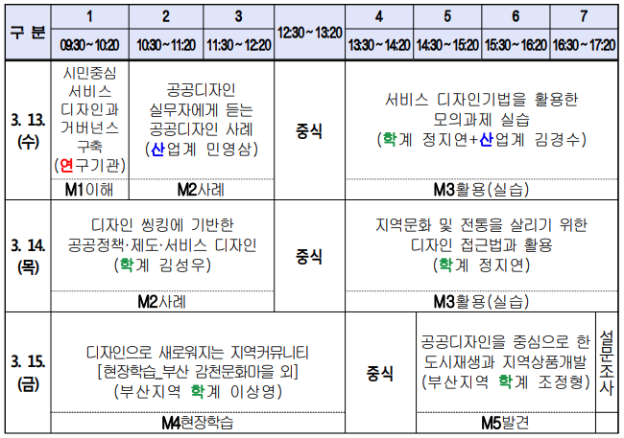
CASE
Daegu Metropolitan City’s [Public Design Course]
Process
Details
• Learning Purpose Feasibility Analysis (Survey)
• 2019 Daegu Metropolitan City Design Week Participation (VOC Survey)
360 Stakeholder Survey (SME/VOC/VOB Survey: n=106)
Task analysis, demand analysis by position/area
Listen
• Classification of Targeted competencies / Target level specification
• Classification of perspectives to ensure justification for development
• Derivation of integrated process goals through gap analysis
Analyze
Content details and development method design
Course goal-contents consistency evaluation
Design of evaluation method for achievement of learning goals
Pilot Testing
Design
• Instructor Pool MGT
Real-Time Lecture MGT
Level 1 Survey (4.5/5.0)
Deliver
Execute
Revise

Slide 13
CASE
Daegu Metropolitan City’s [Public Design Course]
Process
Details
• Learning Purpose Feasibility Analysis (Survey)
• 2019 Daegu Metropolitan City Design Week Participation (VOC Survey)
360 Stakeholder Survey (SME/VOC/VOB Survey: n=106)
Task analysis, demand analysis by position/area
Listen
Subjects | After | Avg. Score | Standard Deviation
Interests | Class | 3.81 | .86 | 0,51 ↑
 |  | 4.32 | .65
Basics | 3 Months | 3.06 | .67 | 1.07 ↑
 |  | 4.13 | .62
Service Design | 3 Months | 2.66 | .87 | 1.44 ↑
 |  | 4.10 | .75
Design Thinking | 3 Months | 2.28 | .73 | 1.75 ↑
 |  | 4.03 | .75
Public Design | 3 Months | 2.34 | .83 | 1.56 ↑
 |  | 3.90 | .70
Civil Recycle | 3 Months | 3.38 | .71 | 0.85 ↑
 |  | 4.23 | .72
Job relevancy | 3 Months | 3.25 | .98 | 0.49 ↑
 |  | 3.74 | .73
• Classification of Targeted competencies / Target level specification
• Classification of perspectives to ensure justification for development
• Derivation of integrated process goals through gap analysis
Analyze
Content details and development method design
Course goal-contents consistency evaluation
Design of evaluation method for achievement of learning goals
Pilot Testing
Design
• Instructor Pool MGT
Real-Time Lecture MGT
Level 1 Survey (4.5/5.0)
Deliver
• Behavior Analysis Survey (3 months)
Applicability Survey (4.53/5.00)
Execute
• Field Applicability
• Obstacles Analysis Survey
Course Necessity & Revision Survey (4.73/5.00)
Revise

Slide 14
CASE
Lessons
It is necessary to focus more on the change from 'Learning' in terms of cost to 'Performance', which is the subject of organizational performance improvement.

Slide 15
CASE
Lessons
It is necessary to focus more on the change from 'Learning' in terms of cost to 'Performance', which is the subject of organizational performance improvement.
As interest in measuring educational effect increases, it is necessary to establish a detailed evaluation system.

Slide 16
CASE
Lessons
It is necessary to focus more on the change from 'Learning' in terms of cost to 'Performance', which is the subject of organizational performance improvement.
As interest in measuring educational effect increases, it is necessary to establish a detailed evaluation system.
More attention needs to be paid to ‘transfer of knowledge’.
And changes in behavior and sophistication of systematic performance evaluation are becoming more important.

Slide 17
CASE
Lessons
It is necessary to focus more on the change from 'Learning' in terms of cost to 'Performance', which is the subject of organizational performance improvement.
As interest in measuring educational effect increases, it is necessary to establish a detailed evaluation system.
More attention needs to be paid to ‘transfer of knowledge’.
And changes in behavior and sophistication of systematic performance evaluation are becoming more important.
Each agency needs to design its own systematic process that reflects the agency's goals and characteristics.

Slide 18
CASE
Lessons
It is necessary to focus more on the change from 'Learning' in terms of cost to 'Performance', which is the subject of organizational performance improvement.
As interest in measuring educational effect increases, it is necessary to establish a detailed evaluation system.
More attention needs to be paid to ‘transfer of knowledge’.
And changes in behavior and sophistication of systematic performance evaluation are becoming more important.
Each agency needs to design its own systematic process that reflects the agency's goals and characteristics.
It is necessary to continuously think about the improvement points and educational effectiveness based on the needs of the field

Slide 19
CASE
Lessons
It is necessary to focus more on the change from 'Learning' in terms of cost to 'Performance', which is the subject of organizational performance improvement.
As interest in measuring educational effect increases, it is necessary to establish a detailed evaluation system.
More attention needs to be paid to ‘transfer of knowledge’.
And changes in behavior and sophistication of systematic performance evaluation are becoming more important.
Each agency needs to design its own systematic process that reflects the agency's goals and characteristics.
It is necessary to continuously think about the improvement points and educational effectiveness based on the needs of the field
The policy and systemic support that will strengthen the sense of responsibility and mission as a partner of the organization and customers are very important.

Slide 20
Thank You

